Slide 1
CHAPTER 3
THERAPEUTIC RANGE
And
ROUTES OF ADMINISTRATION
Part 1

Slide 2
PROPER DRUG ADMINISTRATION
PROPER DRUG ADMINISTRATION is not simply calculating the correct amount of medication to prescribe to a patient.
There are many factors that play into making sure the patient is properly medicated
ALL DRUGS ARE POTENTIAL POISONS!

Slide 3
PROPER DRUG ADMINISTRATION
The CORRECT drug must be prescribed at the CORRECT dosage to be given in the CORRECT route at the CORRECT time to the CORRECT patient. It must be labeled CORRECTLY, explained to the client CORRECTLY and documented CORRECTLY. There are many opportunities for error.

Slide 4
The goal of medicating is to deliver the desired drug concentration within the target area of the body to achieve the desired effect.
MORE drug is not better, LESS drug is not better. The more drug given, the more opportunities for organ damage to occur. The less amount of drug that is given, the less likely that the proper drug levels will be produced and the patient may not benefit from the medication.

Slide 5
THERAPEUTIC RANGE
Toxicity
range
Drug
Conc.
Therapeutic
range
Subtherapeutic
range
Time

Slide 6
THERAPEUTIC RANGE
THE THERAPEUTIC RANGE is the drug concentration in the body that produces the desired effect in the animal with minimal or no signs of toxicity.
The drug dosage is determined by laboratory and clinical testing to keep the drug levels in the therapeutic range in the body.

Slide 7
What makes a drug get in and stay in the THERAPEUTIC RANGE?
Maintaining a balance between the rate of drug entry into the body, absorption, distribution, metabolism, and excretion of the drug.
Health of the animal
MAJOR FACTORS:
  ROUTE OF ADMINISTRATION
  DOSE
  DOSAGE INTERVAL

Slide 8
ROUTE OF ADMINISTRATION
How a drug is administered and how it enters into the body
2 MAJOR CATEGORIES
    PARENTERAL: Route that does not involve the GI tract
    NONPARENTERAL: Route that involves the GI tract

Slide 9
What determines the ROUTE?
DRUG FACTORS
Different effects when given in different ways
An injectable has to be water soluble when administered IV
Stomach acid can inactivate some drugs, causing them to not be given orally

Slide 10
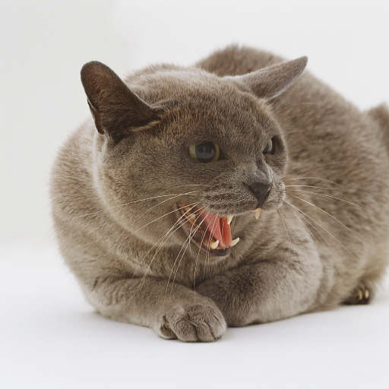
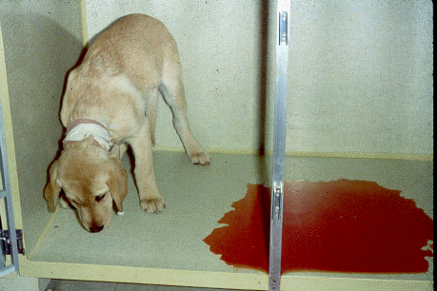
What determines the ROUTE?
ANIMAL FACTORS
Ease of medication
Vomiting animals cannot receive medications orally
Critically ill animals need
animals quickly, requiring
medication to be administered IV

Slide 11
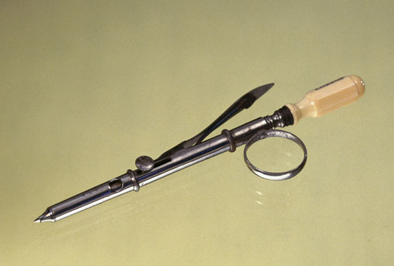
A little bit of Lagniappe
Designed by Francis Rynd (1801-1861), this instrument was used for deep injections.
It is made of steel with an ivory handle, and was manufactured by Weiss.
Rynd, an Irish physician, invented the hollow needle in 1844.

Slide 12
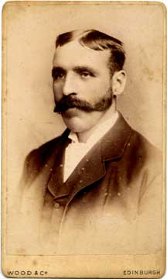
Alexander Wood
(1817 - 1884)
Dr Wood first injected a patient
with morphine in 1853.
His wife became the first IV
morphine addict.
The first recorded fatality
from a
hypodermic-syringe
induced overdose was
Dr Wood's wife.

Slide 13
TRYPANOPHOBIA
TRYPANOPHOBIA is the extreme and irrational fear of medical procedures involving injections or hypodermic needles.
It is occasionally referred to as aichmophobia, belonephobia, or enetophobia, names that are technically incorrect because they simply denote a “fear of pins/needles”.
The name that is in common usage is simply needle phobia.

Slide 14
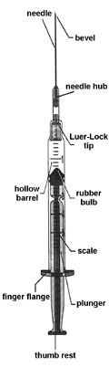
Parts of the syringe
BARREL - part of the syringe that
holds the medication. Has
markings on the outside to
facilitate measuring meds
PLUNGER – movable cylinder inserted
in barrel to form a tight-fitting seal. How
medication is drawn into and pushed
out of the barrel

Slide 15
Parts of a syringe
Flange – located at the of the
barrel where the plunger is inserted.
It forms a ring around the barrel
for the index and middle fingers to be
placed when drawing up solutions.
Tip – End of the barrel where the
needle is attached

Slide 16
3 Most Common Routes of Injections
Intravenous (IV)
Intramuscular (IM)
Subcutaneuous (SC, SQ)

Slide 17
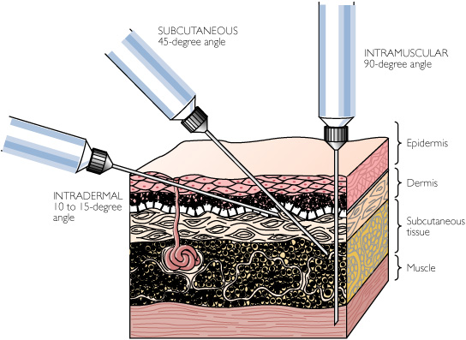

Slide 18
PREFIXES
Intra – within
Inter – between
Sub – under
Epi – above
Trans - across

Slide 19
INTRAVENOUS
  rapid onset of action
  predictable concentration of drug levels in body and higher levels than other routes initially
  shorter duration of action
  Facilitates administration of an irritating drug
  Composed of either aqueous solutions or emulsions (mixture of 2 immiscible liquids dispersed among each other)

Slide 20
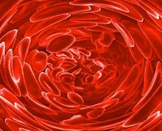
Intravenous cont’d
IV injections are given in 3 different ways:
BOLUS: injecting a concentrated mass of a drug in a minute amount of fluid with only a needle and syringe. Used to achieve immediate high concentrations of drugs.
INTERMITTENT: diluting a drug dose in a small volume of fluid and administering it during a 30-60 minute period via an indwelling catheter. Used to maintain blood levels of antibiotics.

Slide 21
Intravenous cont’d
INFUSION – administration of large volumes of fluid continuously over extended periods of time

Slide 22
IV RISKS
drug could be administered too rapidly
injection not performed in a sterile manner
drugs not properly mixed
risk of air or foreign particles causing an embolus

Slide 23
INTRAMUSCULAR
Onset of action within ~30 minutes
Provides reliable blood levels
Longer duration of action than IV, shorter duration of action than oral
No irritating solutions
Option for fractious animals
Absorption depends on vehicle, rate depends on formulation

Slide 24
INTRAMUSCULAR
Rate of absorption depends on formulation (solution vs. suspension) or vehicle
Solution – clear liquid preparation that contains one or more solvents and one or more solutes. Blood levels within 5 minutes.
Suspension – liquid preparation that contains solid drug particles suspended in a suitable medium. Absorbed more slowly – prolonged introduction into the bloodstream.
Repository/Depot Preparation – Placing an injectable drug in a substance (such as an oil) that delays absorption (ex: Depo-Medrol). Depo = long acting

Slide 25
INTRAMUSCULAR
THINGS TO REMEMBER:
Always pull back on the plunger to be sure that you are not in a blood vessel before you inject.
Don’t give the injection too shallow; you risk not getting the drugs into the muscle.
IM injections can be painful.

Slide 26
SUBCUTANEOUS
Placing a drug into the connective tissue underneath the dermis of the skin
Faster onset than oral, slower than IM (fewer blood vessels)
Longer duration of action than IM
No irritating solutions
Can inject large volumes (SC fluids)
Blood levels are similar to oral administration
Temperature affects absorption

Slide 27
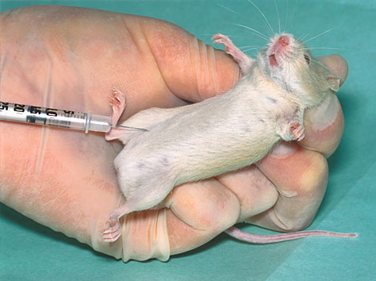
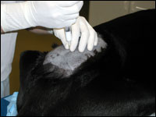
OTHER INJECTABLE ROUTES:
Intraperitoneal
  Risk of peritonitis and penetrating organs
  Large surface area for blood absorption
Epidural/Subdural/Intrathecal
  Diagnostic procedures and administering anesthetic agents
  Risks of spinal injections or drugs traveling cranially

Slide 28
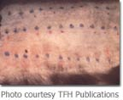
OTHER INJECTABLE ROUTES
Intra-arterial
  Used to treat a specific organ (very high levels at a certain site)
  Can be done accidentally
Intradermal
  Between dermis and epidermis
  Low blood levels, slow absorption
  Local treatments or allergy testing

Slide 29
OTHER INJECTABLE ROUTES:
Intracardiac
  Rapid blood levels
  Emergencies and euthanasias
Intra-articular
  Must use aseptic technique
Intramedullary/Intraosseous
  Rapid blood levels
  Not common, painful
  Rapid fluid administration (femur/humerus)

